Slide 1
Linux System
PASS: looks good
Lab Assignment
email address: parth2@pdx.edu
partner’s email address: NA

Slide 2
Instructions: Make a copy of this document, place the copy into your submissions folder, fill it with your responses and include a link to it when you submit via the lab assignment submission form. If you work on this with a partner then include your partner’s email address in the assignment submission form and on the title page of this document.
With each question, use the space on the slide to show your response. Add additional slides as needed.
Paste images into the document as needed.
Use the Assignment Submission Form to submit your completed assignment

Slide 3
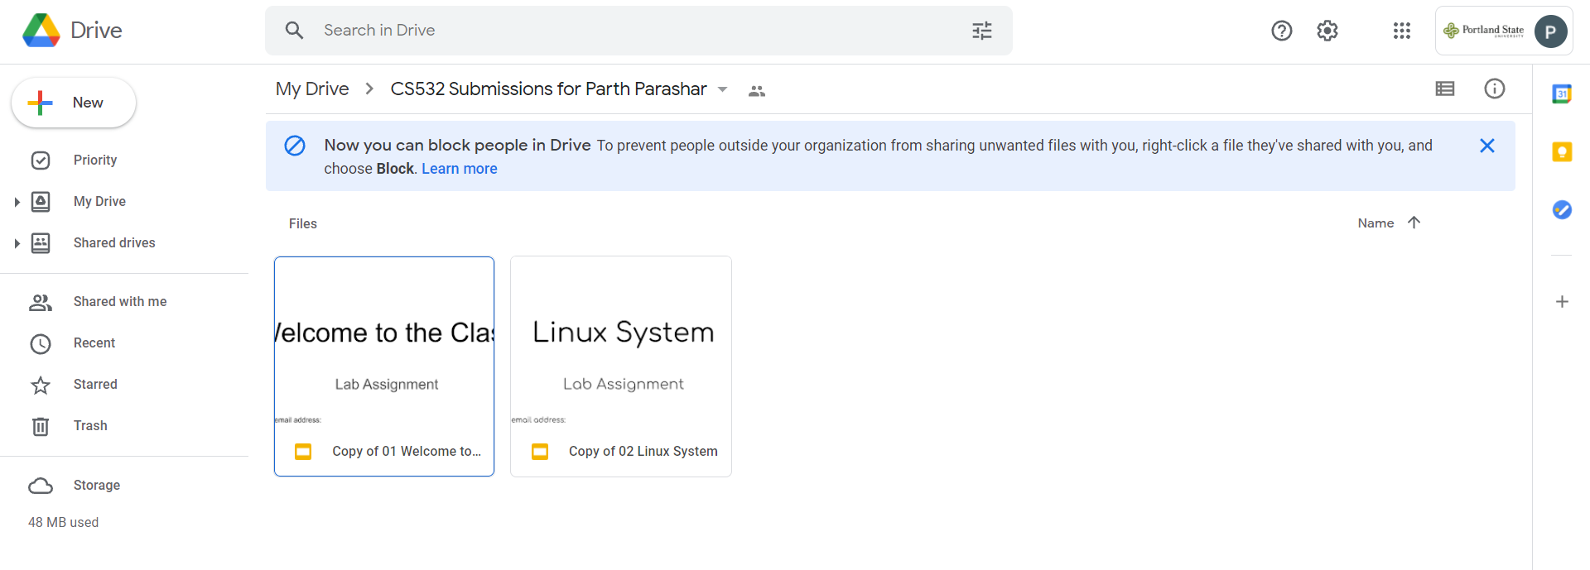

Slide 4
1. login to linux.cs.pdx.edu using ssh <userid>@linux.cs.pdx.edu
If you are unable to login then first read the useful documentation at https://cat.pdx.edu/2021/09/20/remote-access-to-mcecs-computer-labs-fall-2021/
After reading the documentation, if you are still unable to resolve your access issue then contact CAT by sending an email to support@cat.pdx.edu

Slide 5
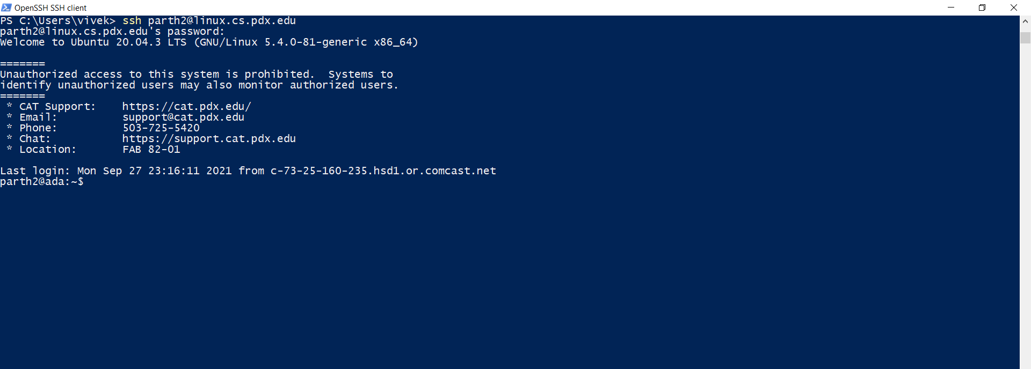

Slide 6
2. ssh to linux.cs.pdx.edu and then create a CS532 directory. Use the cd command to create your new directory. To find out more about the cd command or any Linux command, use the man command, like this:
man cd
if you don’t like the name ‘CS532’ then choose a different name. In general the professor will not need to find or access this directory, so you are free to call it anything you like.

Slide 7
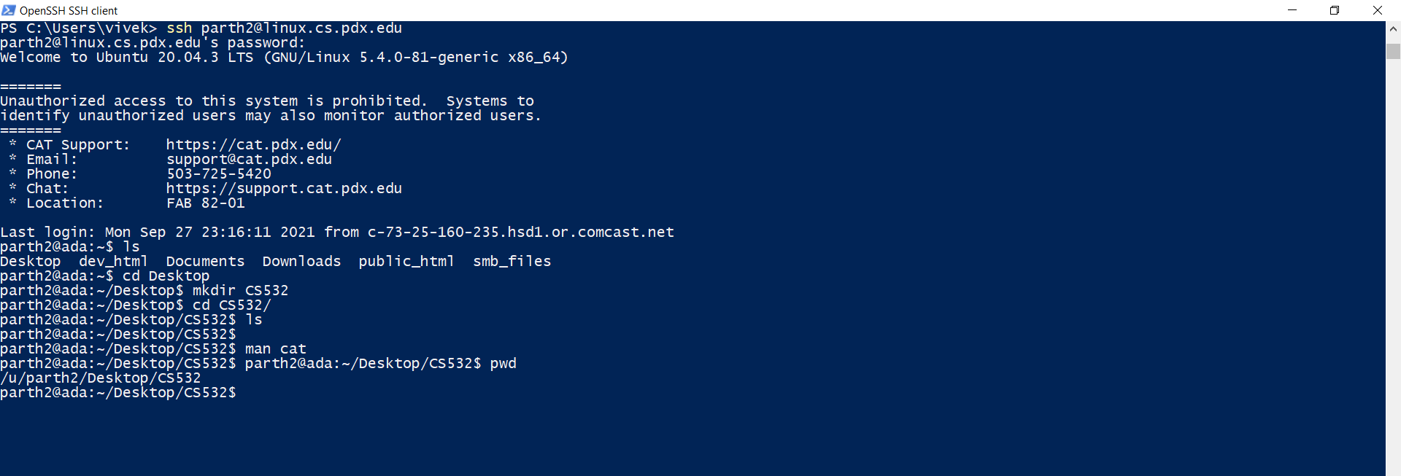
I have created a folder named CS532 in the directory Desktop and the current directory is displayed using the pwd command.

Slide 8
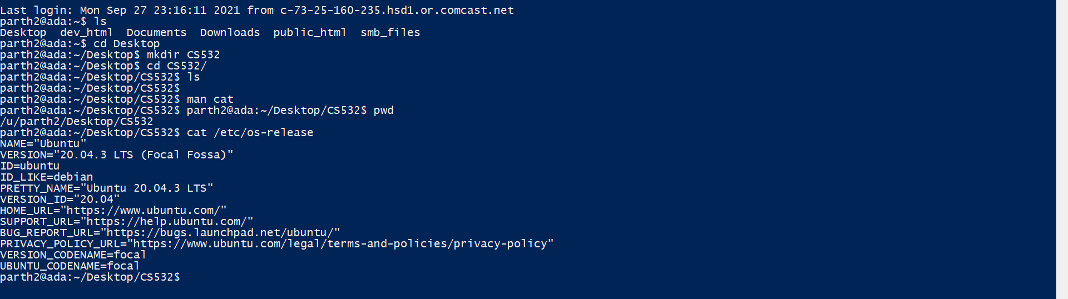
3. What version of Linux is running on linux.cs.pdx.edu?
You can find this by running printing out the /etc/os-release file, like this: cat /etc/os-release
The output of the command cat /etc/os-release is displayed above with the linux version as :- Ubuntu 20.04.3 LTS

Slide 9
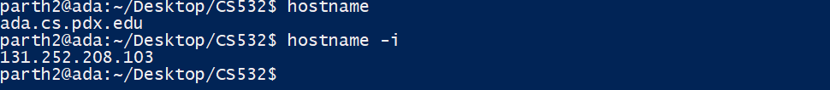
4. We call it linux.cs.pdx.edu but that is not the real name of the host. What is the real name of the host? To find this, try the hostname command.
The hostname and hostname -i commands which are used to know the username and ip address of the connected server is displayed in the screenshot above.

Slide 10
5. (optional) Configure SSH Keys
Every time you login to linux.cs.pdx.edu with ssh you are prompted for your password. This is a pain and is mostly a waste of time if you always login from the same trusted laptop or desktop computer.
A more convenient way to do it is to configure SSH Keys so that your client (your laptop or desktop) becomes trusted so that you can login without a password. You can configure this with SSH Keys.
See this tutorial for more information about how to configure SSH Keys for a linux server such as linux.cs.pdx.edu: link
This is optional; you can skip this step if not interested

